Slide 1




FACIAL EXPRESSION RECOGNITION
know what behind your face!
Supervised by AST Mansour Elhosseiny Eng. Ali Elshenawy

Slide 2

ABOUT US
We are team from egypt digital pioneers creating a FER model :
·Youstina Ashraf Khalil Mikhail
·Hosam Mohsen Mohamed Hassan
·Hager Yasser Mohamed
·Mo’men Mohsen Mahmoud Helmy
·A’laa Abdel Nasser Mohamed

Slide 3

INTRODUCTION
Facial Expression Recognition (FER) is the process of identifying human emotions based on facial cues. It uses computer vision and machine learning techniques to analyze facial expressions captured in images or videos.

Slide 4
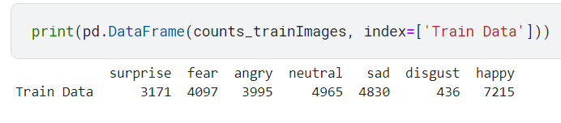
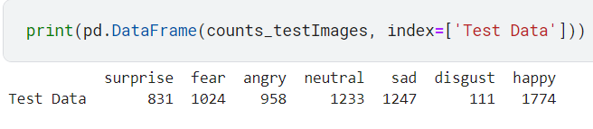
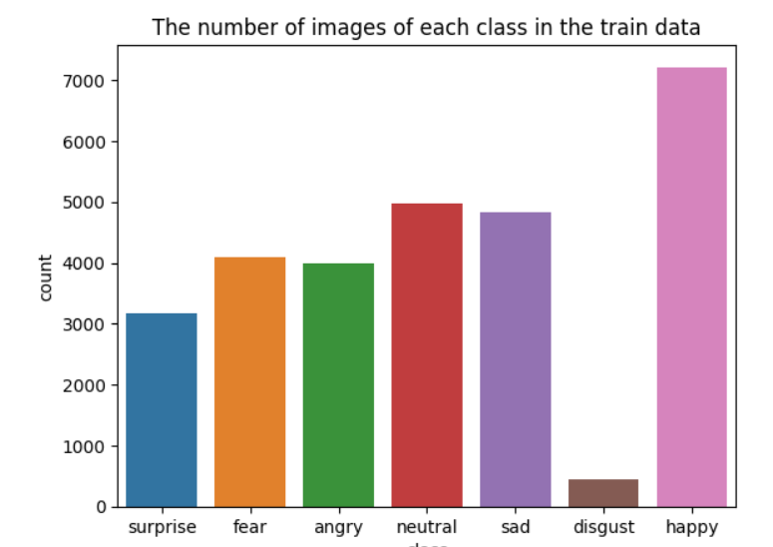
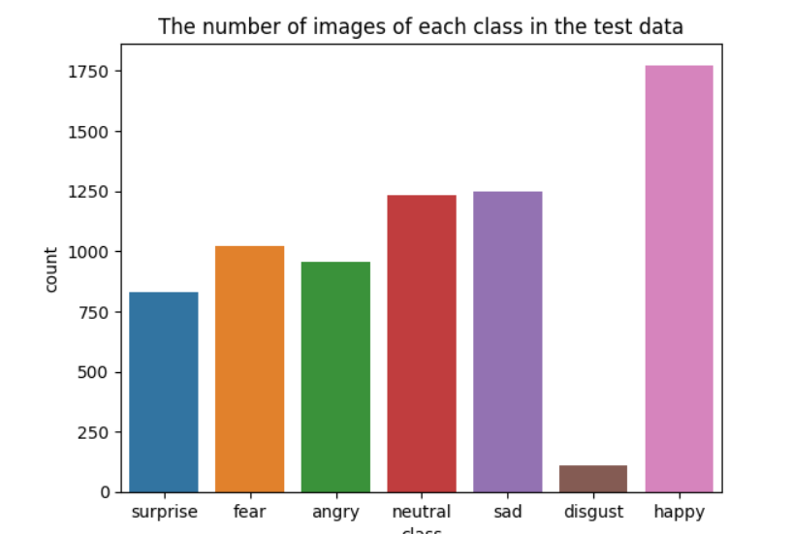
DATASET OVERVIEW

Slide 5
Preprocessing:
-Drop class Disgust due to lack of images. -Balanced Data using RandonOverSampler. -Preprocessing image using ImageDataGenerator.

Slide 6
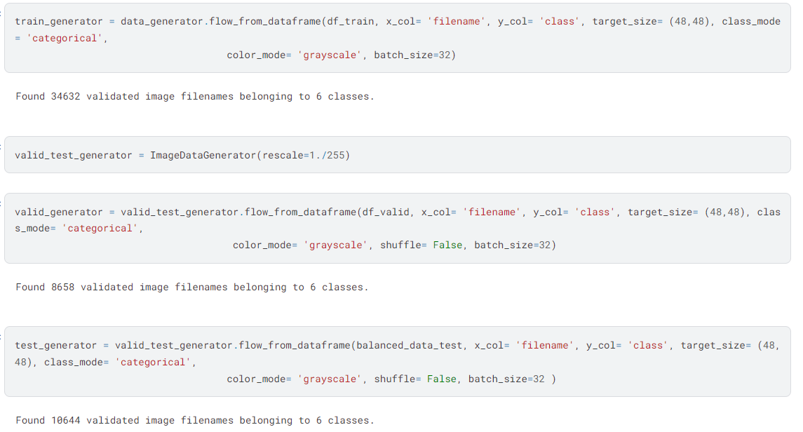
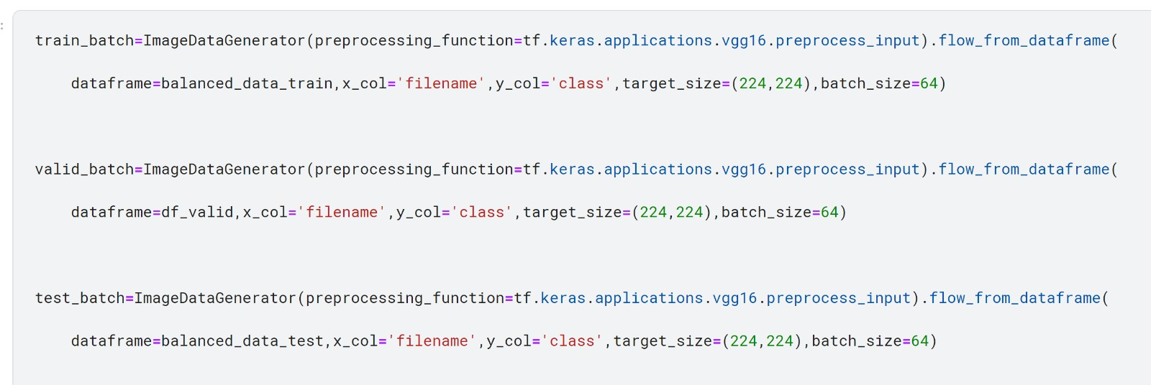
MODEL
Preprocessing using ImageDataGenerator
CNN
VGG16

Slide 7
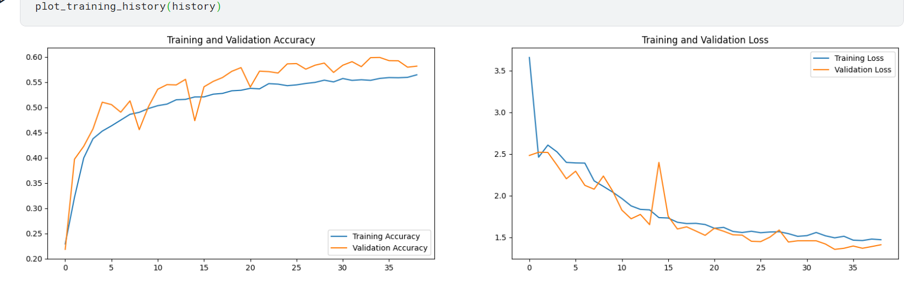
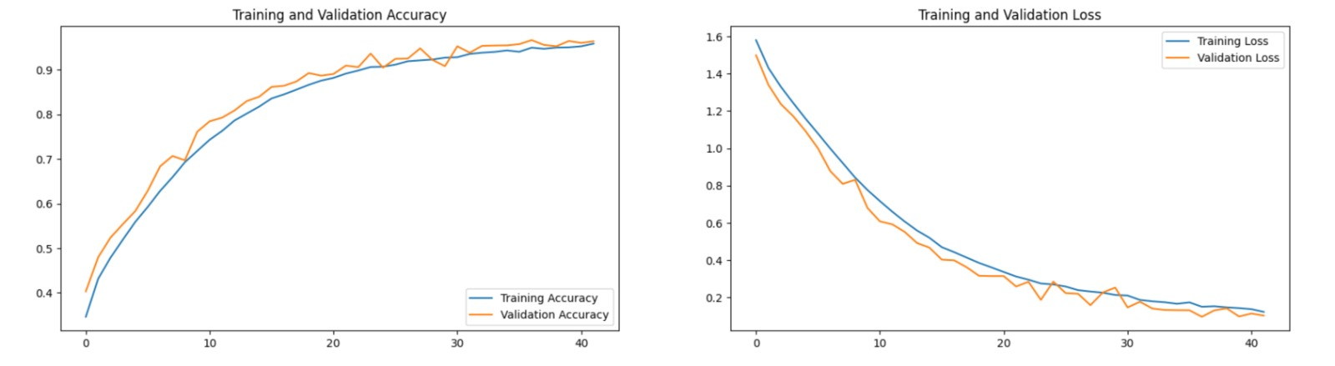
Train Accuracy and Loss Vs Valid Accuracy and Loss
CNN
VGG16

Slide 8
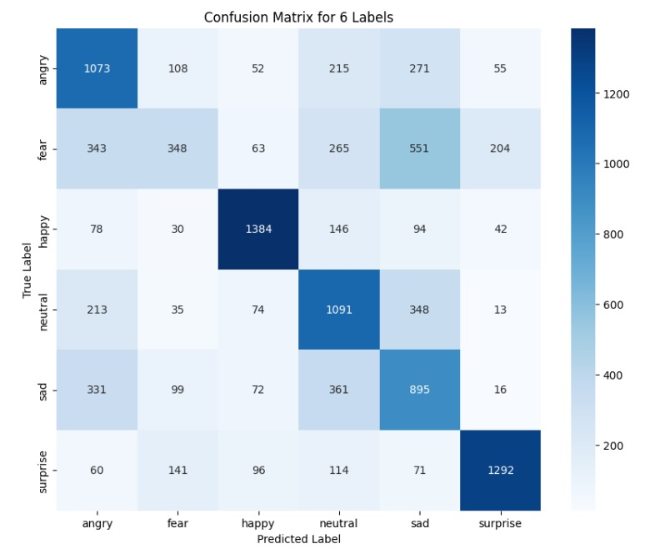
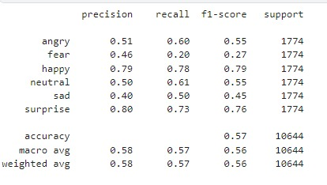
CONFUSION MATRIX
CNN

Slide 9
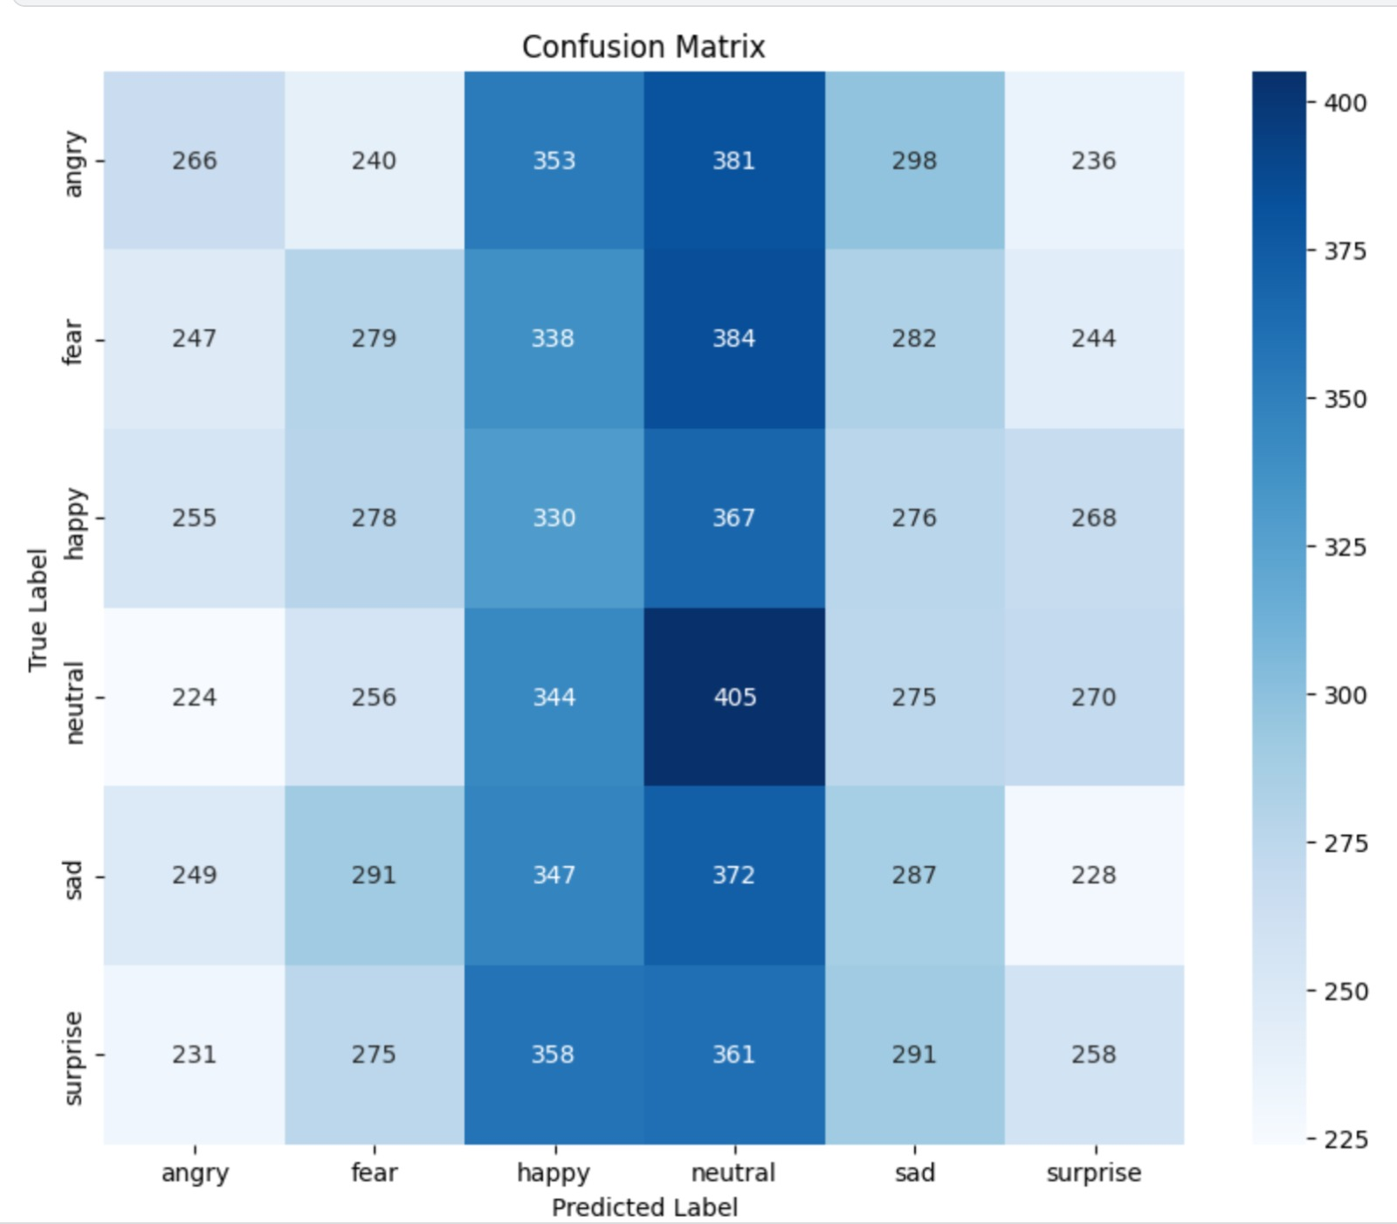
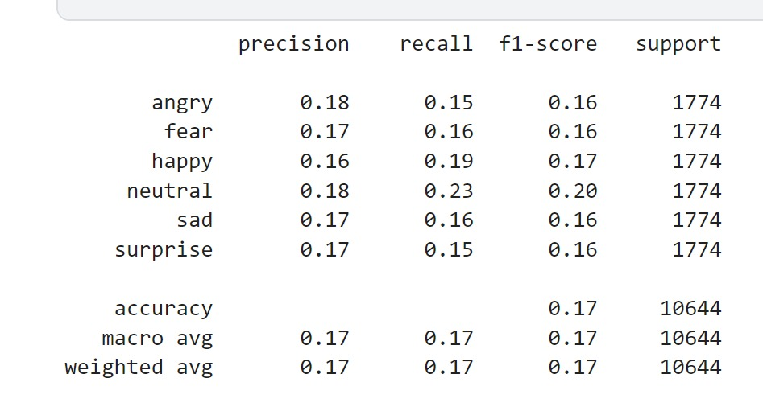
CONFUSION MATRIX
VGG16

Slide 10
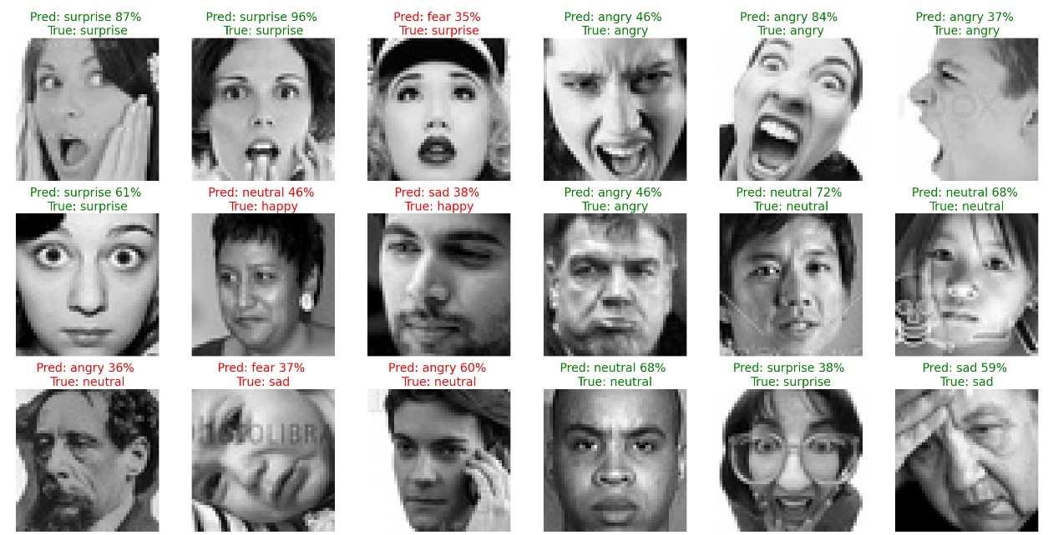

Slide 11
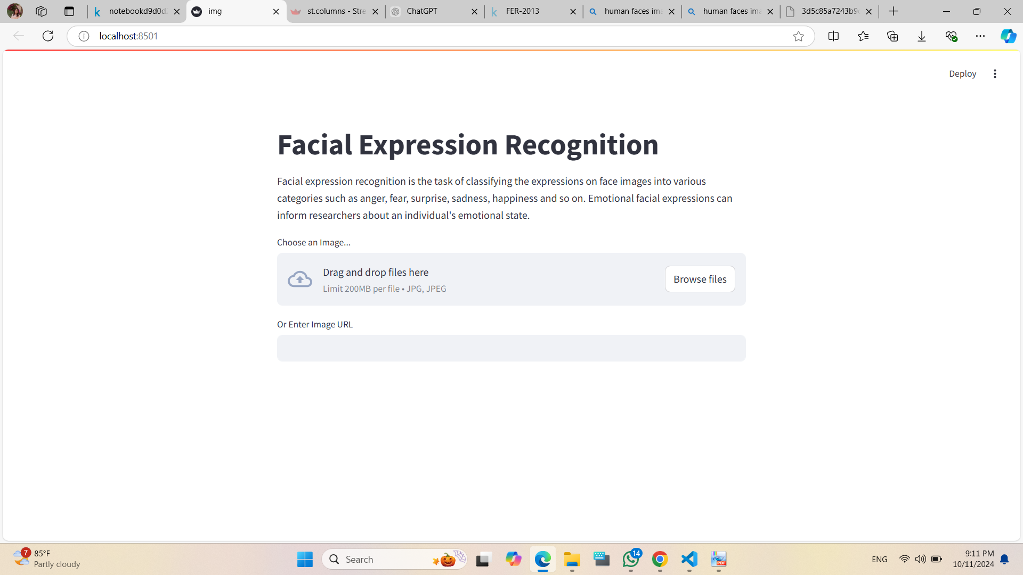
Deployment:

Slide 12
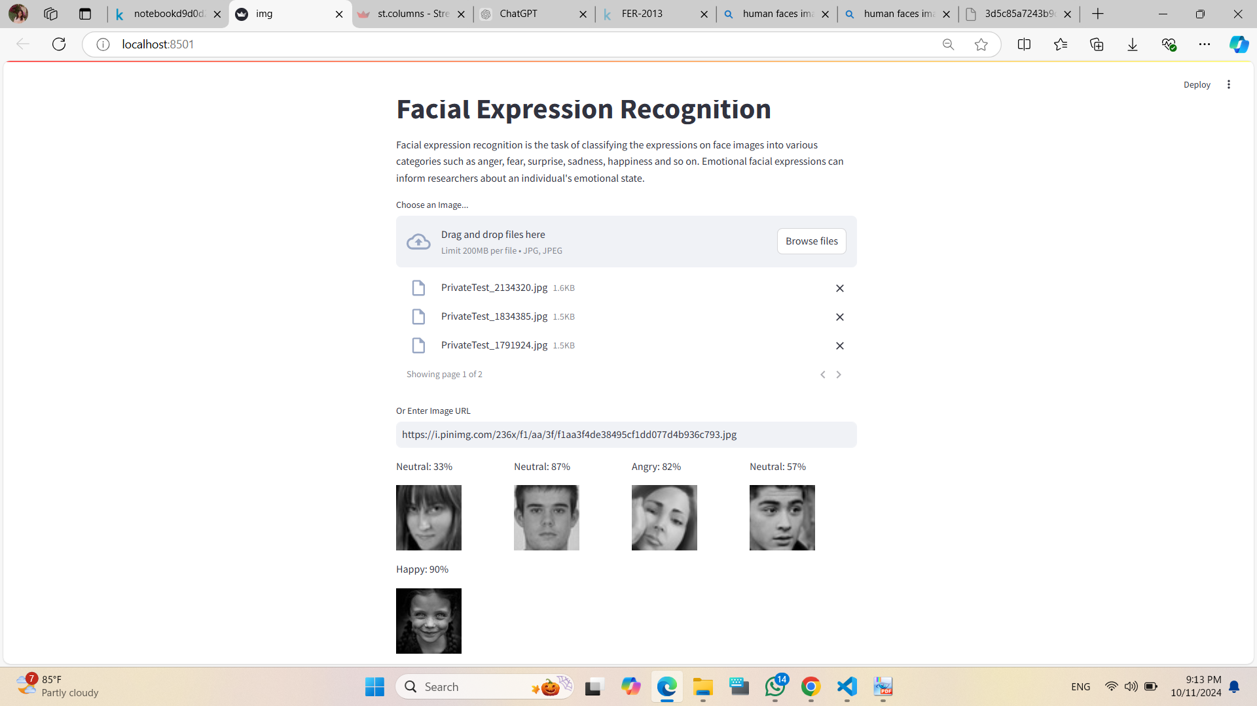
Deployment:

Slide 13
THANK YOU!
FOR YOUR ATTENTION

